Slide 1






Employee Churn Prediction
Student Details
Name: Gladys Rubala M S
NM Id: au91762112029
College Name : Alagappa Chettiar Gov. College of Engineering and Technology, Karaikudi.

Slide 2
Disclaimer
The content is curated from online/offline resources and used for educational purpose only

Slide 3

Course Outline
Abstract
Problem Statement
Aims, Objective & Proposed System/Solution
System Deployment Approach
Model Development & Algorithm
Future Scope
Video of the Project
Conclusion
Reference

Slide 4


Abstract
This project develops a machine learning model to predict employee churn. By analyzing historical employee data, including demographics and employment tenure, our model identifies factors influencing churn and provides insights for retention strategies. Leveraging advanced algorithms like Random Forest and KMeans clustering, our predictive model empowers organizations to proactively address turnover challenges and foster a stable workforce.

Slide 5


Problem Statement
Employee churn, the departure of valuable talent from an organization, creates challenges like increased costs and disruptions. Current methods lack effectiveness in predicting and preventing churn, leading to workforce instability and negative impacts on performance. There is a crucial need for predictive models to identify at-risk employees, enabling organizations to implement proactive retention strategies and foster a stable workforce.

Slide 6

Aim and Objective
Aim: The primary objective of this Final Seminar is to present the outcomes and advancements made in the project “Employee Churn Prediction System.” “

Slide 7
Objectives
Gather and preprocess historical employee data, including demographics, performance metrics, and tenure.
Explore and analyze the dataset to identify patterns and key factors contributing to employee churn.
Develop and train machine learning models, such as Random Forest and KMeans clustering, to predict employee churn.
Evaluate the performance of the predictive models using appropriate metrics and validation techniques.
Implement proactive retention strategies based on model insights to reduce employee turnover and foster workforce stability.
Optimize the predictive model and retention strategies iteratively based on feedback and performance evaluations.

Slide 8

Proposed Solution
Solution: Utilize machine learning algorithms to analyze historical employee data, including demographics, performance metrics, and tenure. Develop a predictive model that identifies patterns and predicts the likelihood of employee churn. KMeans clustering will be employed to extract insights and identify at-risk employees. By leveraging these techniques, organizations can implement proactive retention strategies and optimize workforce management to reduce turnover rates and foster a stable and engaged workforce.
Notes:
8

Slide 9
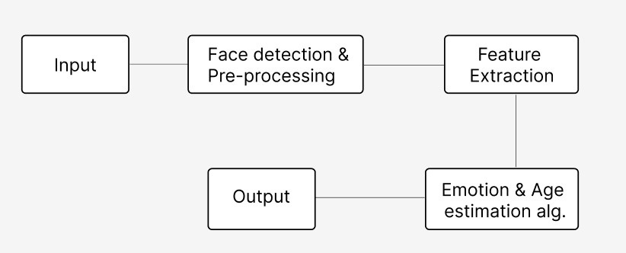
System Deployment Approach
Data Detection and data Pre-processing
Churn Prediction
Notes:
9

Slide 10
Model Development & Algorithm
Dataset Description:
The dataset contains details of employees.
Size of dataset is 10000
Have 10 features
Gender,Psychological and financial features
Each column has around 10000 entries
Notes:
10

Slide 11
Model Development & Algorithm
Data Preprocessing:
Handling Missing Values
Encoding Categorical Variables
Feature Scaling
Feature Selection
Handling Imbalanced Data
Train-Test Split
Notes:
11

Slide 12
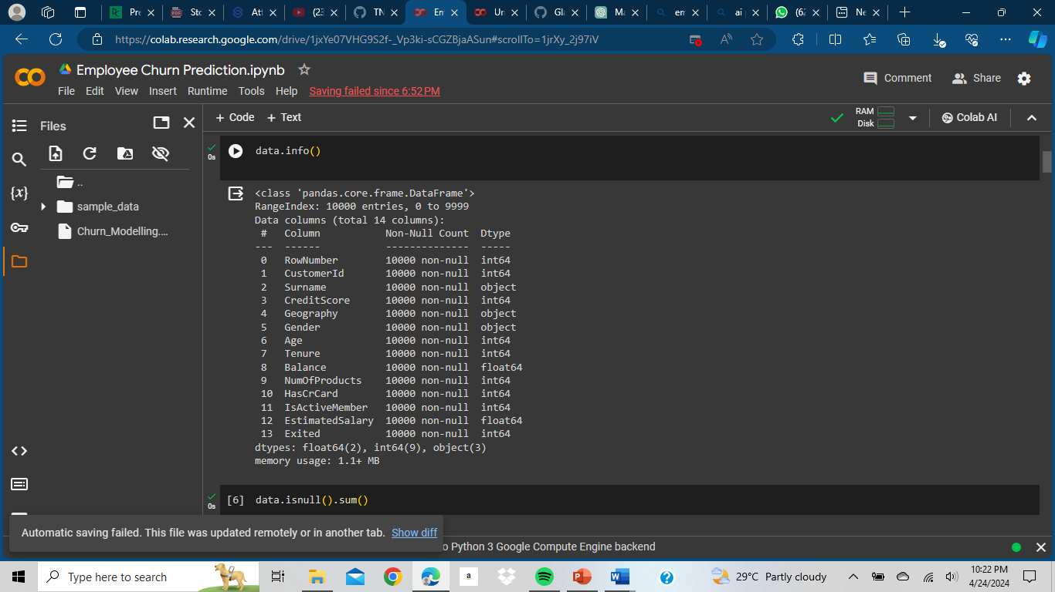
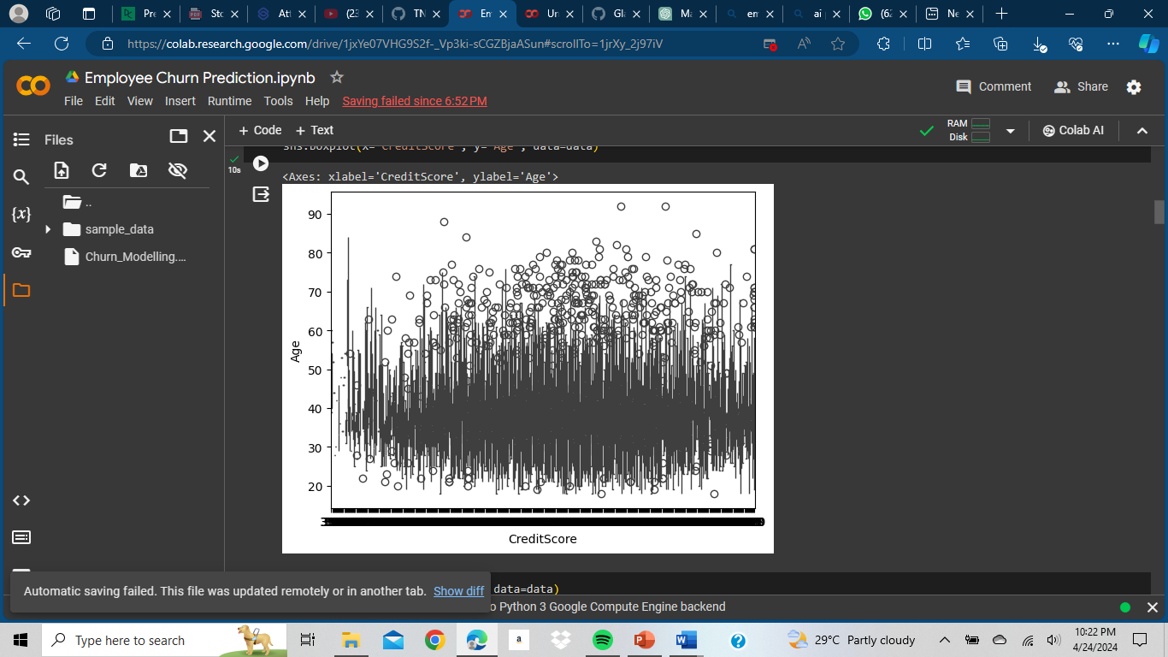
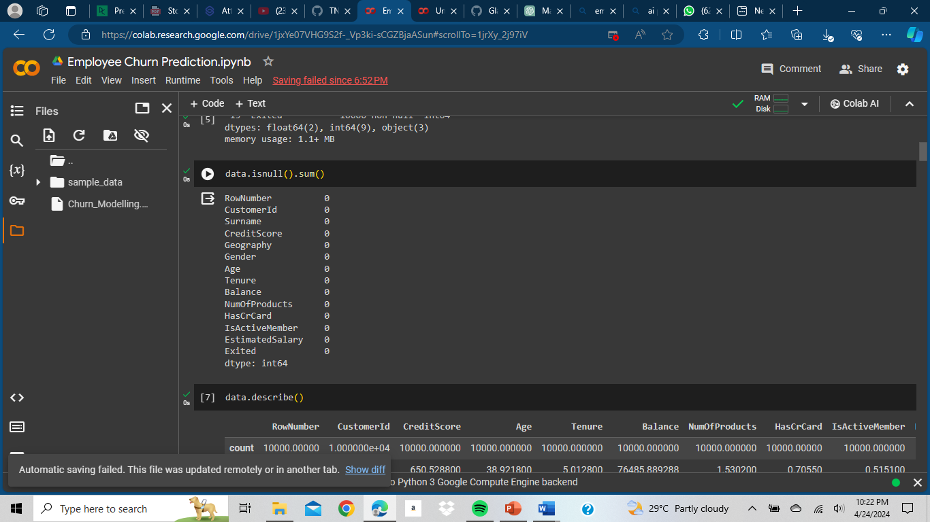
Model Development & Algorithm
Notes:
12

Slide 13
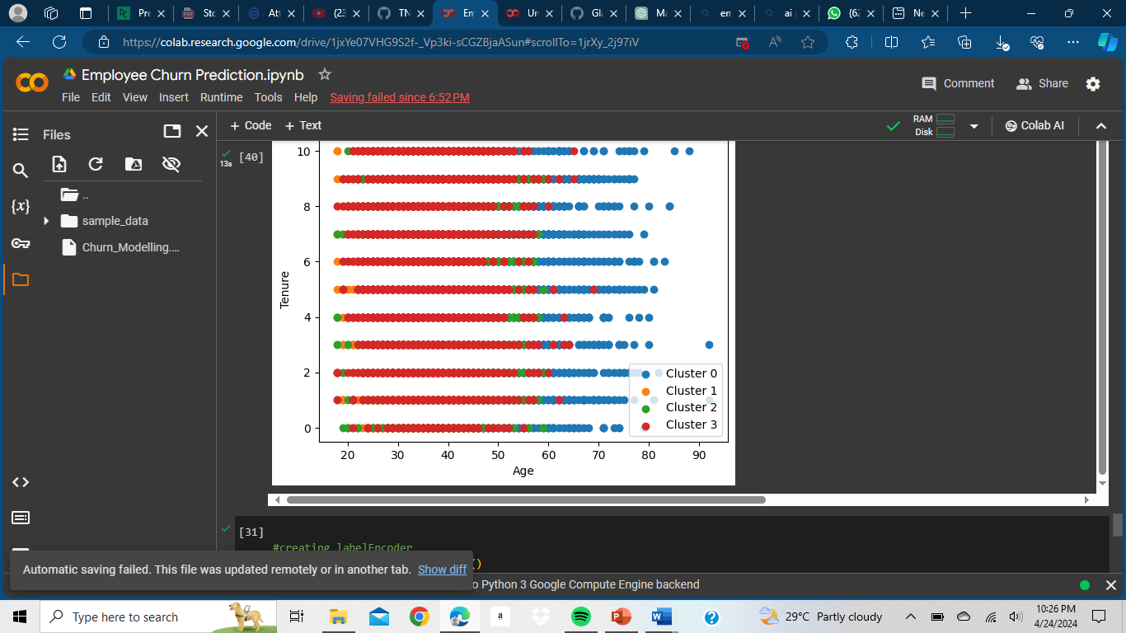
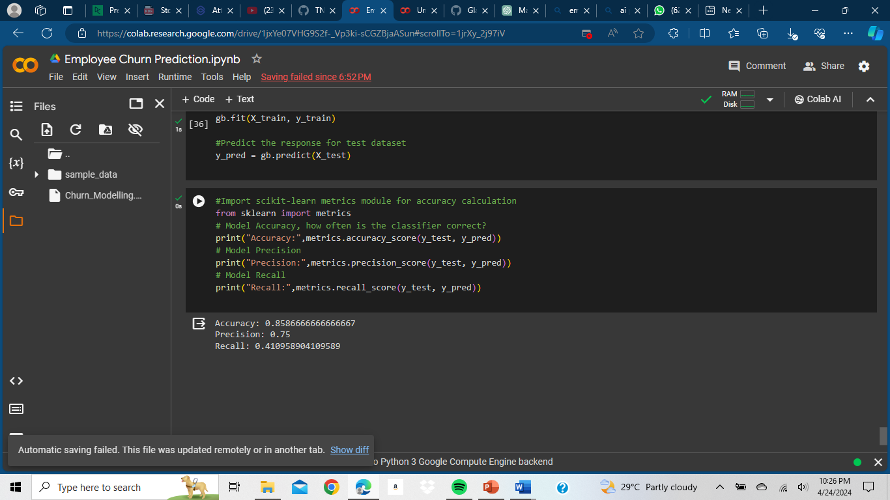
Result
Notes:
13

Slide 14

Future Scope
Real-time Data Integration: Incorporate real-time data for dynamic predictions.
Advanced Analytics: Explore deep learning and NLP for deeper insights.
Personalized Strategies: Tailor retention interventions using ML.
Industry Customization: Customize the model for specific industries.
Longitudinal Analysis: Track churn patterns over time for trends.
Notes:
14

Slide 15
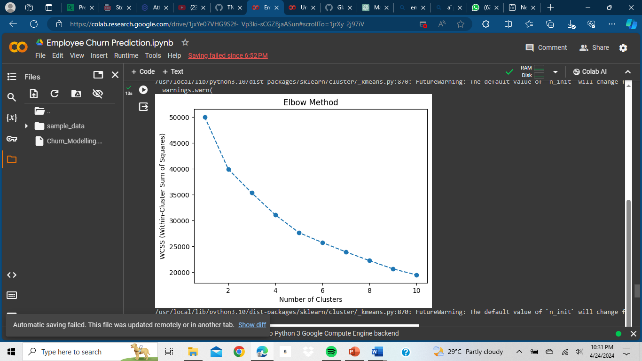
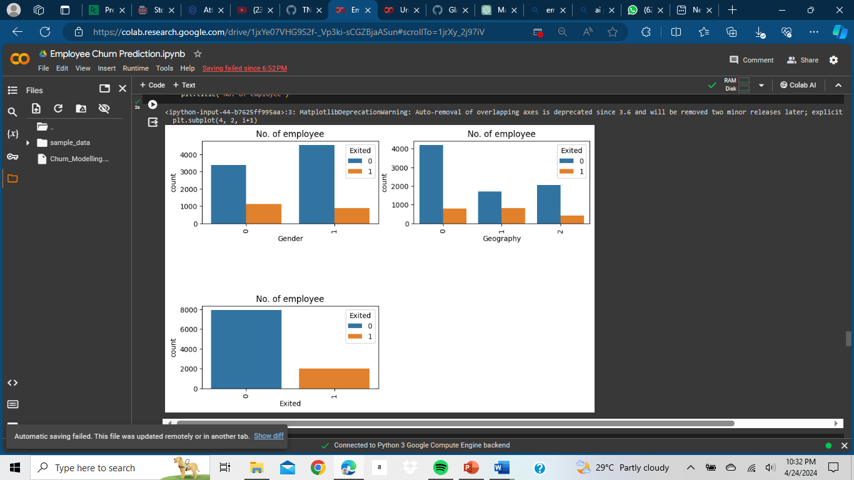
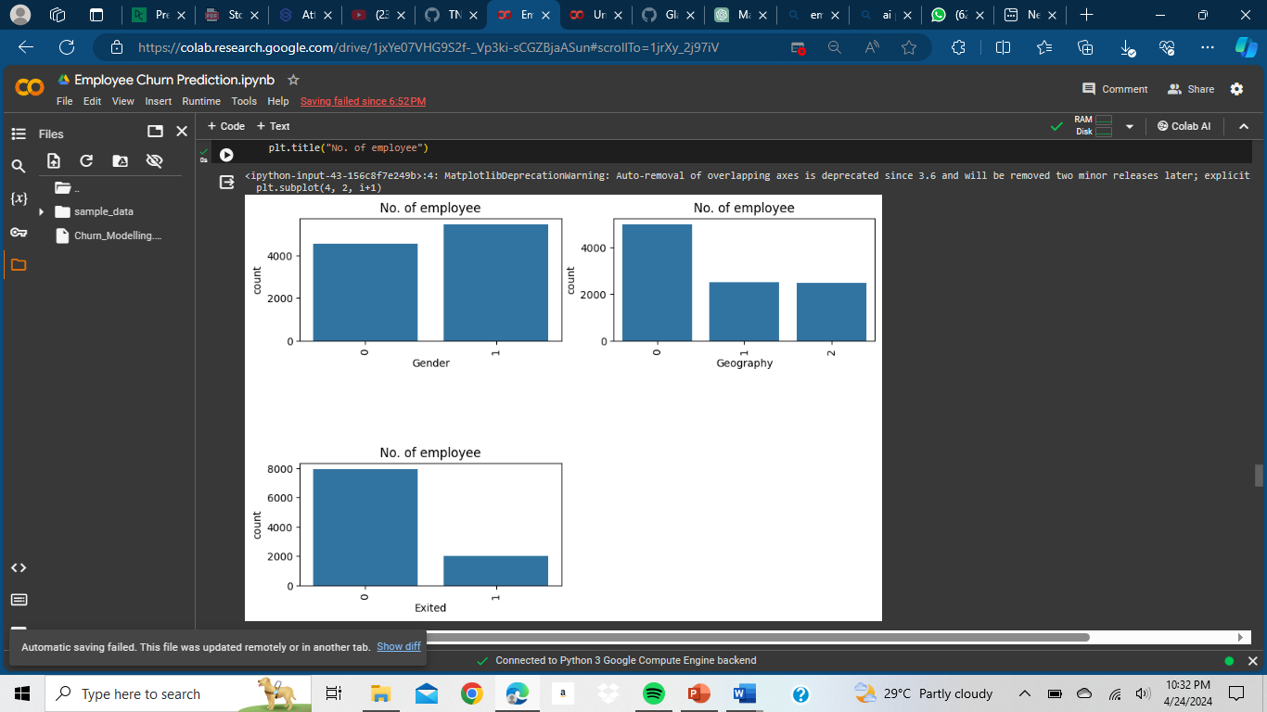
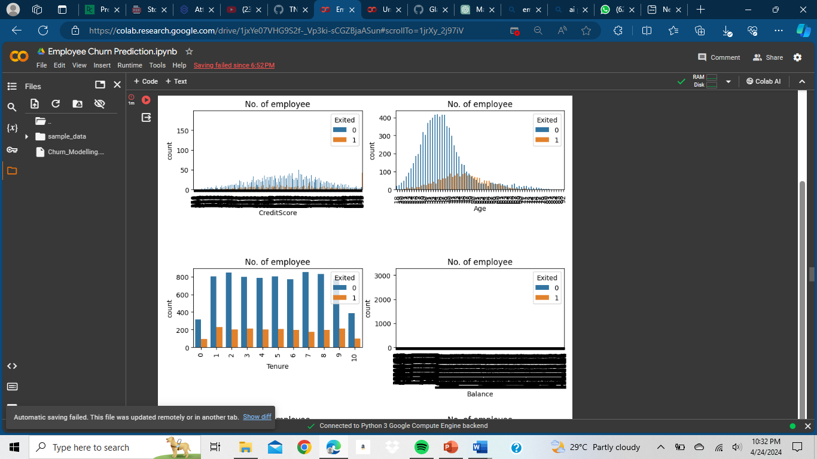
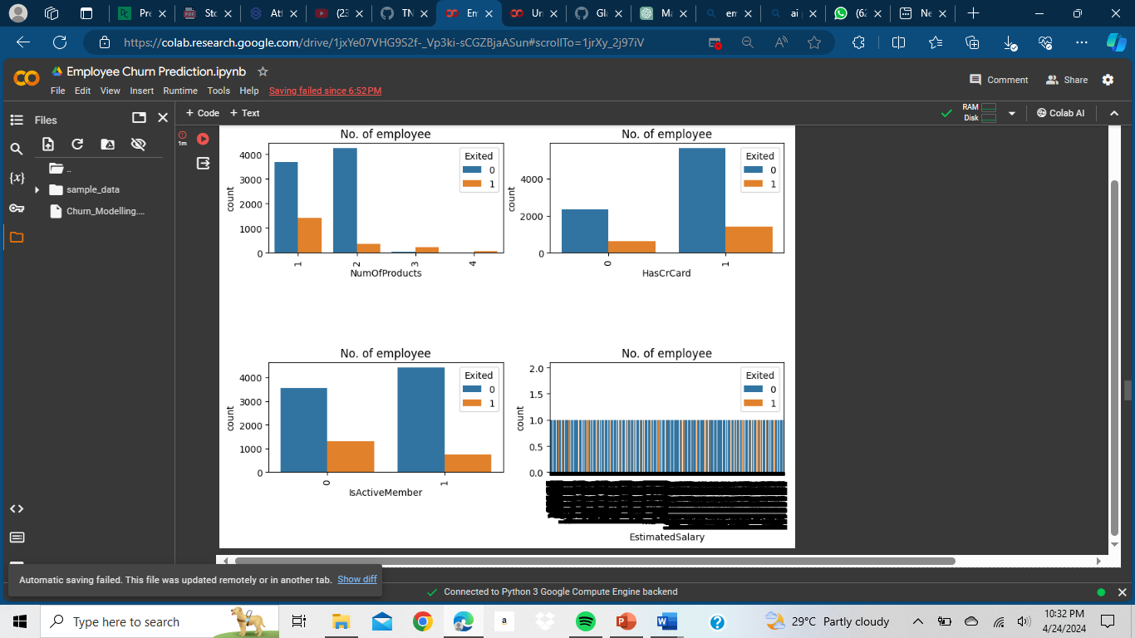
Glimpse of the Project
Notes:
15

Slide 16

Conclusion
In conclusion, our project delivers an effective employee churn prediction model, empowering organizations to identify at-risk employees and implement targeted retention strategies. By reducing turnover rates and fostering workforce stability, businesses can enhance performance and maintain competitiveness in the market.
Notes:
16

Slide 17
Reference
Project Github link, Ramar Bose , 2024
Avinash Navlani, Predicting Employee Churn in Python,datacamp. Predicting Employee Churn in Python | DataCamp
Notes:
Reference
These are the references for this session.

Slide 18
Thank you!
Notes:
18

